Slide 1
Reinforcement Learning
From basics to DQN
Motaz El Saban
Amal Abdel Salam
Karim Farid
Omar Abdel Tawab

Slide 2
RL Workshop Goals
Layout the landscape of the field
What is RL
Main applications
Basic RL taxonomy
Basic RL terminology
Main methods
Focus on Q-learning (method behind famous DeepMind Atari games agent)
Best frameworks
Work on practical examples from simple to hard
Leave the workshop ready to start learning RL after a good overview

Slide 3
Workshop Format
1.25 hour for RL background
1.75 hour practical working on a set of problems
(simple) Taxi environment (tabular Q-learning, discrete)
(medium) Mount Car environment (tabular Q-learning, continuous)
(hard) Atari breakout game (DQN using function approximation)
Make sure you have the VirtualBox VM!
No assumed prior knowledge of RL

Slide 4
Motivating Example
Suppose you’re playing a video game. You enter a room with two doors
Behind Door 1 are 100 gold coins, followed by a passageway
Behind Door 2 is 1 gold coin, followed by a second passageway going in a different direction
Once you go through one of the doors, there is no going back. Which of the doors should you choose?
If you made your decision based solely on maximizing your immediate reward (or score), then your answer would be Door 1
However, the aim of most video games is not to maximize your score in a single section of the game, but to maximize your score for the entire game. After all, there could be 1000 gold coins at the end of the passageway behind Door 2, for all you know.
The only way to really answer this question is to play the game multiple times; try a different door each time; and then based on the information you’ve collected, determine your optimal strategy.
https://towardsdatascience.com/the-other-type-of-machine-learning-97ab81306ce9

Slide 5
Machine Learning Landscape: where RL fits
Semi-supervised learning
Learning Distribution/clustering
Generative models (e.g. GANs)
Anomaly detection
Representation learning
Association rule mining
Machine Learning
Supervised learning
Classification
Regression
Unsupervised learning
Features to discrete label
Model -free
Model-based
Model -free
Model-based
Model –free
Model-based
Model –free
Reinforcement learning
Model-based
Features to continuous label
Learning with delayed rewards
Features to groupings/representation

Slide 6
There is more to this ML landscape
Interpretable/black-box models
Trees
Model explaining: e.g. SHAP
Causality vs inference (the book of why)
Point-estimate vs probabilistic predictions
ML transparency
ML fairness
Probabilistic graphical models
Bayesian deep nets
NeurIPS tutorials https://nips.cc/Conferences/2017/Videos

Slide 7
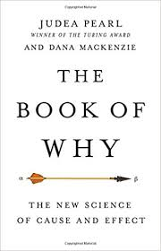

Slide 8
RL Applications

Slide 9
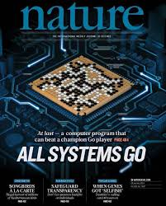
AlphaGo
Picture credit: https://becominghuman.ai/summary-of-the-alphago-paper-b55ce24d8a7c

Slide 10
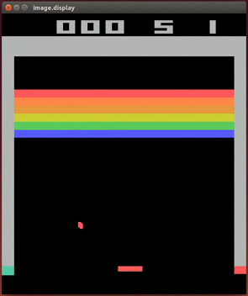
Atari Games
https://www.youtube.com/watch?v=V1eYniJ0Rnk
Picture credit: http://inoryy.com/post/deepmind-starcraft2-next-big-thing-ai/

Slide 11
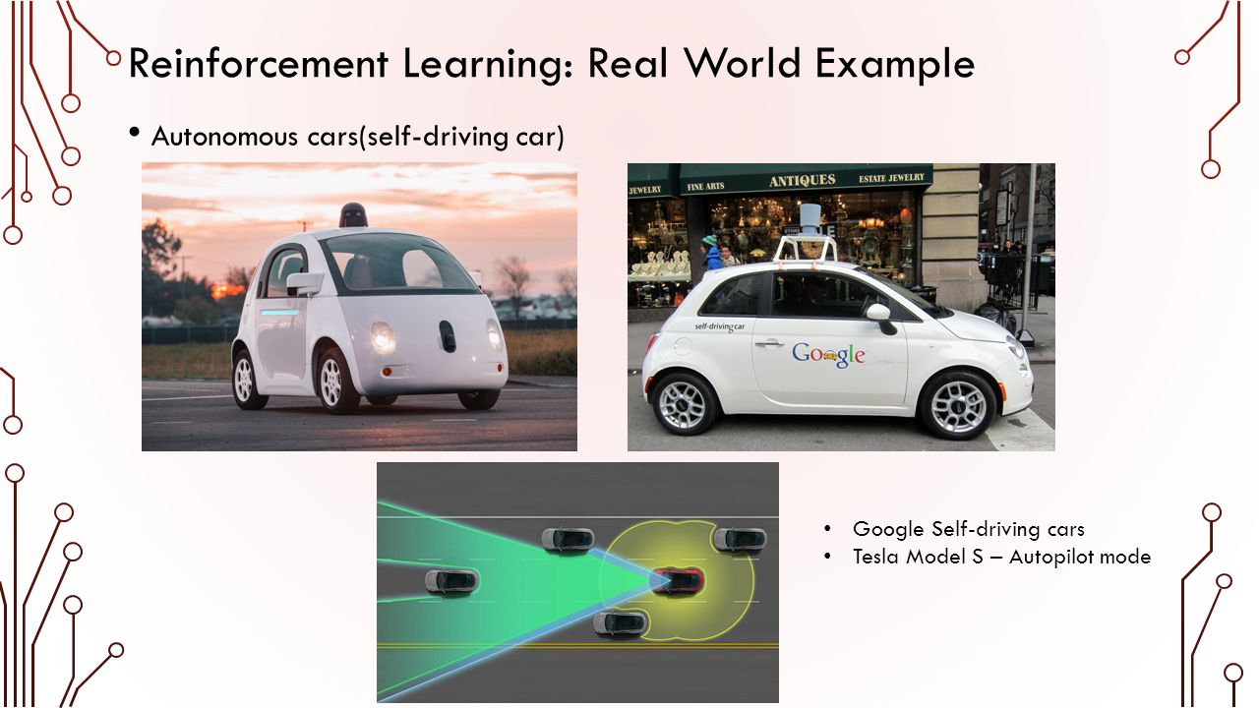
Self Driving cars
Google self driving cars
Tesla Model S
Picture credit: https://slideplayer.com/slide/8983902/

Slide 12
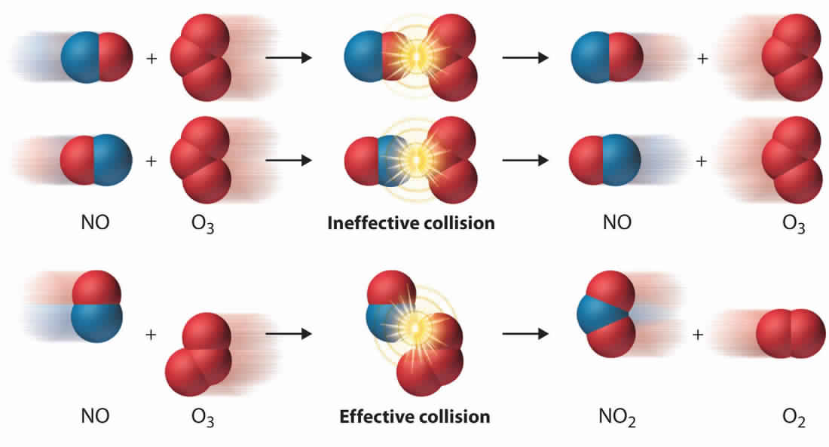
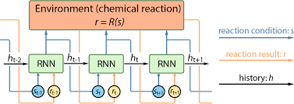
Optimizing chemical reactions
Paper: https://pubs.acs.org/doi/full/10.1021/acscentsci.7b00492
Picture credit: http://mrtremblaycambridge.weebly.com/c7-chemical-reactions.html

Slide 13

RL Introduction
Picture credit: https://i.stack.imgur.com/eoeSq.png

Slide 14
Picture credit: David Silver course on RL http://www0.cs.ucl.ac.uk/staff/d.silver/web/Teaching.html

Slide 15
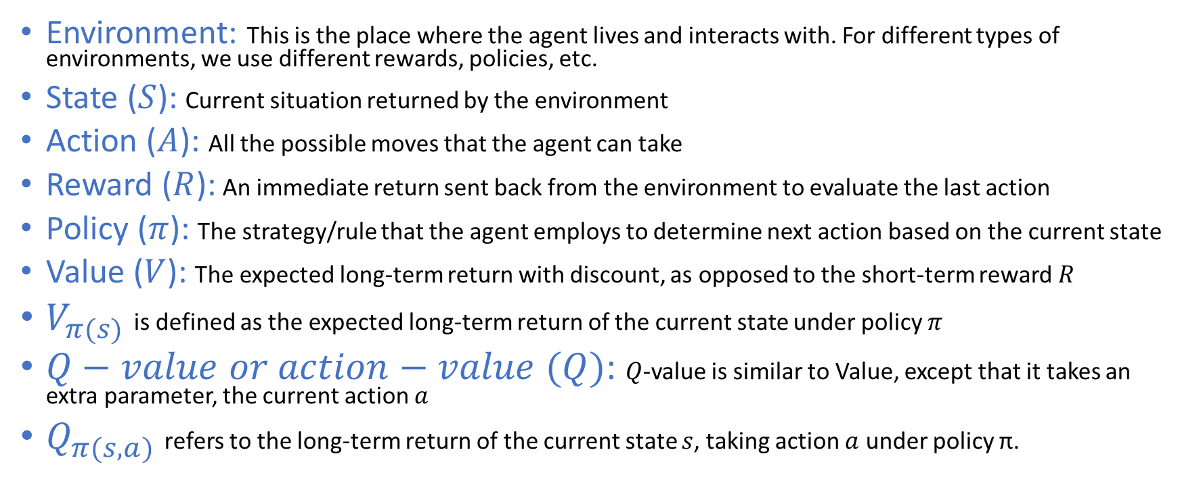
Definitions
Environment: This is the place where the agent lives and interacts with. For different types of environments, we use different rewards, policies, etc.
State ($S$): Current situation returned by the environment
Action ($A$): All the possible moves that the agent can take
Reward ($R$): An immediate return sent back from the environment to evaluate the last action
Policy ($π$): The strategy/rule that the agent employs to determine next action based on the current state
Value ($V$): The expected long-term return with discount, as opposed to the short-term reward $R$
$V_{π(s)}$ is defined as the expected long-term return of the current state under policy $π$
$Q−value or action−value (Q)$: $Q$-value is similar to Value, except that it takes an extra parameter, the current action $a$
$Q_{π(s,a)}$ refers to the long-term return of the current state $s$, taking action $a$ under policy π.

Slide 16
Key characteristics of RL problems
An initially unknown environment
Delayed feedback
Sequential decision making
you must explore the environment in order to gain information about it
after taking an action, it may take some time to fully realize the long-term consequences of that action
the overall reward received is typically the result of a sequence of multiple actions rather than a single stand-alone action

Slide 17
Getting More Formal
Source: Deep RL course Berkley: http://rail.eecs.berkeley.edu/deeprlcourse/

Slide 18
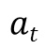
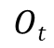
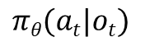
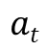
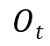
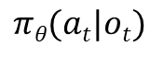
A simple from of learning: Imitation Learning
$$Ot$$
$$πθ(at|ot)$$
$$at$$
Training Data
$$Ot$$
Supervised Learning
$$πθ(at|ot)$$
$$at$$
Deep RL course Berkley: http://rail.eecs.berkeley.edu/deeprlcourse/

Slide 19
Why imitation learning may not work?
Would need lots of labelled data in the form of observation, action
Would suffer from error accumulation over time
Nonetheless with hacks it could work

Slide 20
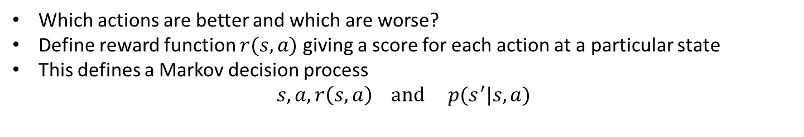
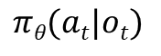
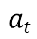
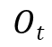
Markov Decision Process & Reward Functions
$$Ot$$
$$πθ(at|ot)$$
$$at$$
Which actions are better and which are worse?
Define reward function $r(s,a)$ giving a score for each action at a particular state
This defines a Markov decision process
$$s, a, r\left(s,a\right) and p(s^{′}|s,a)$$
High reward
Low reward
Deep RL course Berkley: http://rail.eecs.berkeley.edu/deeprlcourse/

Slide 21
Taxonomy of RL approaches
RL algorithms come in two varieties: “model-based” and “model-free”
With “model-based” RL, we determine the optimal course of action (also known as the optimal policy) using a pre-determined model of our environment: transition probabilities & rewards (which may or may not be accurate)
while with “model-free” RL, our aim is to determine the optimal policy by interacting with the environment

Slide 22
Taxonomy of RL approaches
Model-free RL algorithms can, in turn, be split into two types: “on-policy” and “off-policy”, relating to how we interact with the environment in order to gather information about it.
With “on-policy” algorithms, we make decisions about our actions based on our “best” policy at the time of making the decision and then use the information/reward gathered from taking that action to improve on the best policy.
With “off-policy” algorithms, on the other hand, our behavior in interacting with (or exploring) the environment may be unrelated to what we believe to be the best optimal at the time of taking the action.
For example, we may deliberately choose to take an action that we know to be sub-optimal in the short term in order to determine if it results in a greater reward in the long term.
Q-Learning is a “model-free, off-policy” RL algorithm.

Slide 23
Observability and Markovian assumptions
In model-based RLs, the environment could be fully observable or partially observable.
There can be environments that are Markovian Decision Problems (MDP) or non-Markovian.
Thus we have a combination based on “observability of environment” and “behavior of the environment”.
To be more specific, we can say a model is MDP, or Partially Observable MDP (POMDP), or a non-MDP, etc.

Slide 24
Model free RL
Model-free RLs do not have any knowledge about the environment in which the agent acts
The agent only acts in any given state, but doesn’t know where it leads to. So they rely on the instantaneous reward obtained by taking an action in a state, and then evaluate the utility of that state
Utility is defined as the expected total reward from the current state to the goal-state (using the concepts of state-value function and state-action pairs)
Once all the paths are traversed they then evaluate the utilities of each of the states experienced.
As always, the action sequence that yields the maximum utility is considered as the optimal policy. So they learn the utilities by trial-and error method
Some of the most popular, legacy model-free RL algorithms are:
Q-learning
SARSA
Temporal Difference (TD)
We will mostly focus on model-free RL

Slide 25
Another RL Taxonomy
Policy Improvement
Directly optimize for the policy
Value/Action-Value methods
Find Value/Action-Value
Example methods: policy gradient
Derive optimal policy from derived Value/Action-Value
Popular algorithm: Q-learning, SARSA
Hybrid methods using both Value and policy optimization
Example: Actor-Critic
Good for large and continuous state/action spaces
Simpler formulation
Can handle large/continuous spaces by discretization or function approximation

Slide 26
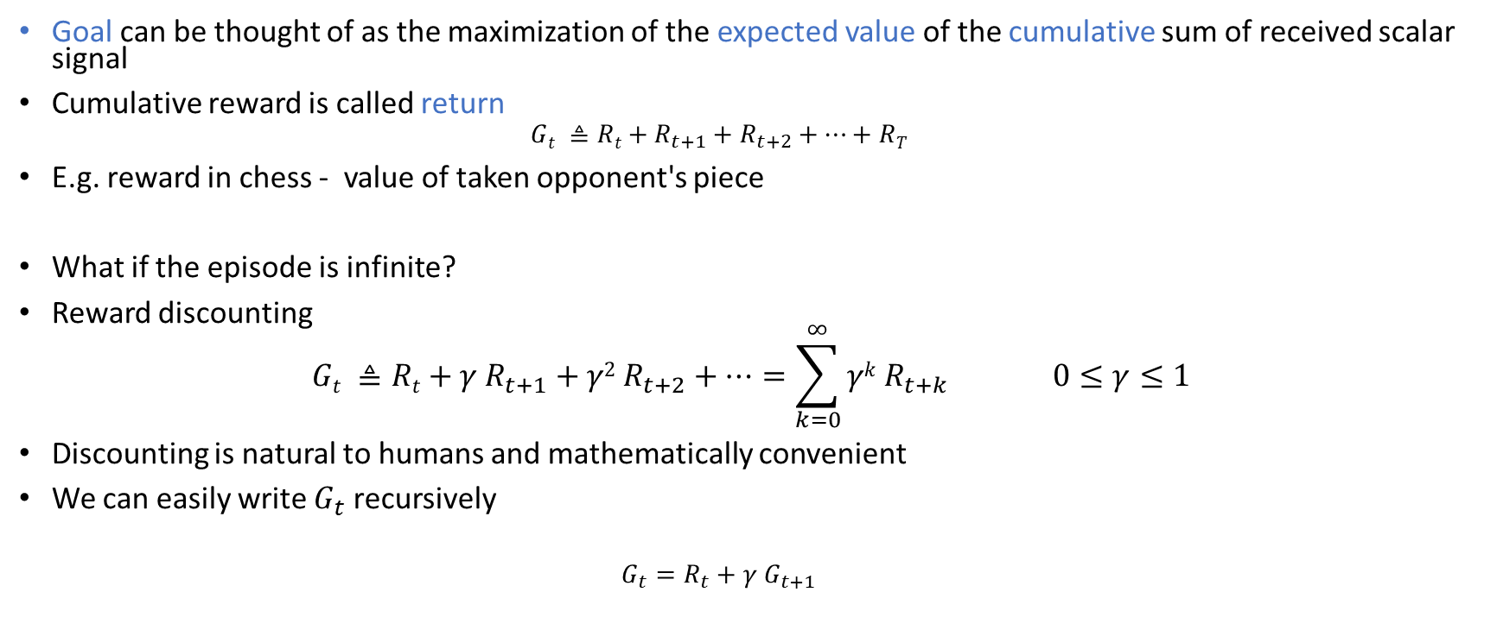
Reward Hypothesis (R. Sutton)
Goal can be thought of as the maximization of the expected value of the cumulative sum of received scalar signal
Cumulative reward is called return
$$Gt ≜Rt+R_{t+1}+R_{t+2}+…+RT$$
E.g. reward in chess - value of taken opponent's piece
What if the episode is infinite?
Reward discounting
$$Gt ≜Rt+{γ R}_{t+1}+{γ2 R}_{t+2}+…=\sum_{k=0}^{∞}{γk R_{t+k} } 0≤γ≤1$$
Discounting is natural to humans and mathematically convenient
We can easily write $G_{t}$ recursively
$$G_{t}=R_{t}+γ G_{t+1}$$

Slide 27
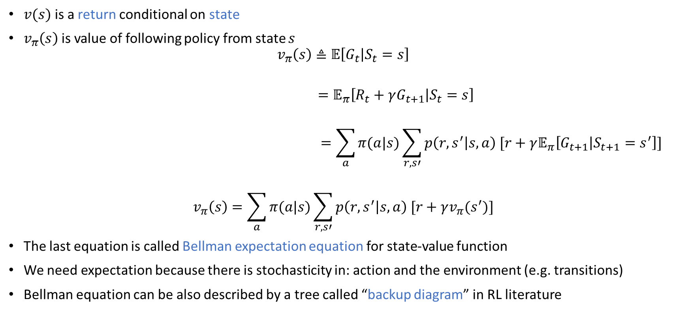
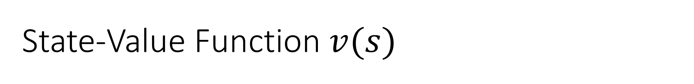
State-Value Function$v(s)$
$v(s)$is a return conditional on state
$v_{π}\left(s\right)$is value of following policy from state $s$
$$v_{π}\left(s\right)≜𝔼\left[G_{t} | S_{t}=s\right]$$
$$=𝔼_{π}\left[R_{t}+γG_{t+1} | S_{t}=s\right]$$
$$=\sum_{a}{π(a|s)\sum_{r,s′}{p\left(r,s^{′} | s,a\right) [r+γ𝔼_{π}\left[G_{t+1} | S_{t+1}=s^{′}\right]]}}$$
$$v_{π}\left(s\right)=\sum_{a}{π(a|s)\sum_{r,s′}{p\left(r,s^{′} | s,a\right) [r+γv_{π}(s^{′})]}}$$
The last equation is called Bellman expectation equation for state-value function
We need expectation because there is stochasticity in: action and the environment (e.g. transitions)
Bellman equation can be also described by a tree called “backup diagram” in RL literature
Environment stochasticity
Policy stochasticity

Slide 28
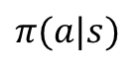
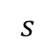
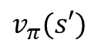
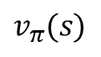
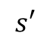
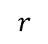
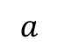
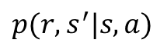
Backup Diagrams
$$s$$
$$v_{π}(s)$$
$$π(a|s)$$
$$a$$
$$r$$
$$p(r,s^{′}|s,a)$$
$$s′$$
$$v_{π}(s′)$$

Slide 29
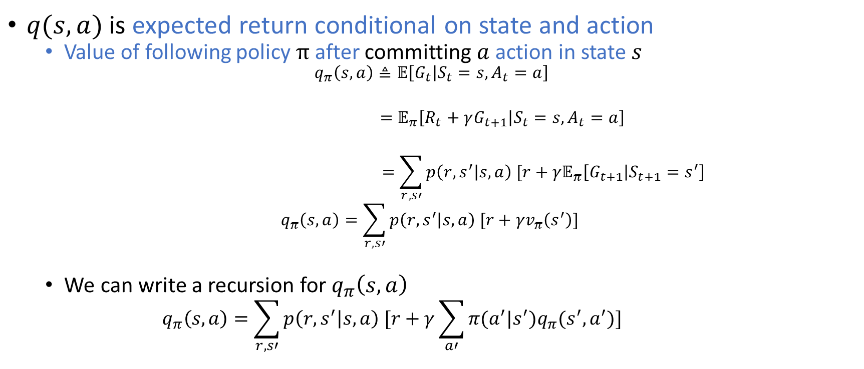
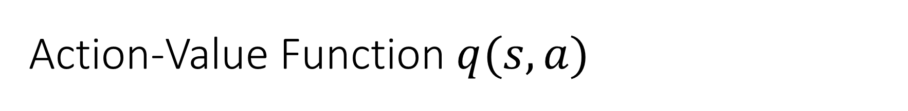
Action-Value Function $q(s,a)$
$q(s,a)$ is expected return conditional on state and action
Value of following policy $π$after committing $a$ action in state $s$
$$q_{π}\left(s,a\right)≜𝔼\left[G_{t} | S_{t}=s, A_{t}=a\right]$$
$$=𝔼_{π}\left[R_{t}+γG_{t+1} | S_{t}=s, A_{t}=a\right]$$
$$=\sum_{r,s′}{p\left(r,s^{′} | s,a\right) [r+γ𝔼_{π}\left[G_{t+1} | S_{t+1}=s^{′}\right]}$$
$$q_{π}\left(s,a\right)=\sum_{r,s′}{p\left(r,s^{′} | s,a\right) [r+γv_{π}\left(s^{′}\right)] }$$
We can write a recursion for $q_{π}\left(s,a\right)$
$$q_{π}\left(s,a\right)=\sum_{r,s′}{p\left(r,s^{′} | s,a\right) [r+γ\sum_{a′}{π(a^{′}|s^{′})q_{π}(s^{′},a^{′})}] }$$

Slide 30
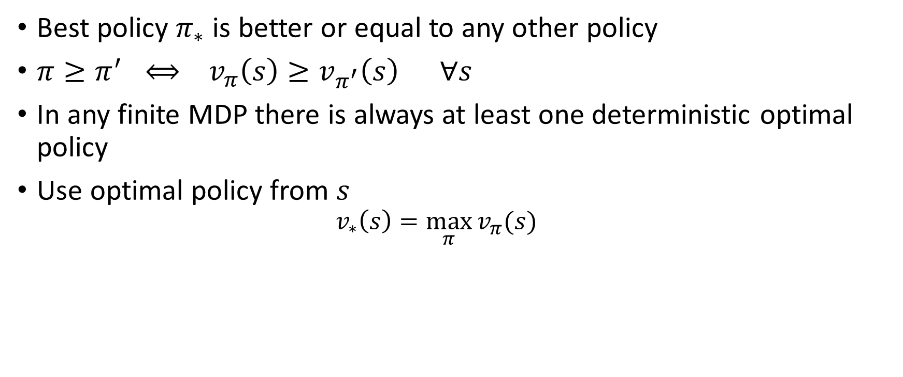
Optimal Policy
Best policy $π_{∗}$ is better or equal to any other policy
$π≥π^{′} ⟺ v_{π}\left(s\right)≥v_{π^{′}}\left(s\right) ∀s$
In any finite MDP there is always at least one deterministic optimal policy
Use optimal policy from $s$
$$v_{∗}\left(s\right)=\max_{π}{v_{π}(s)}$$

Slide 31
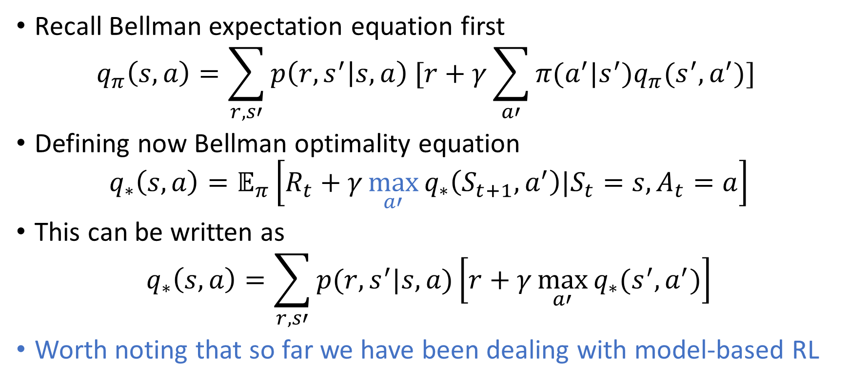
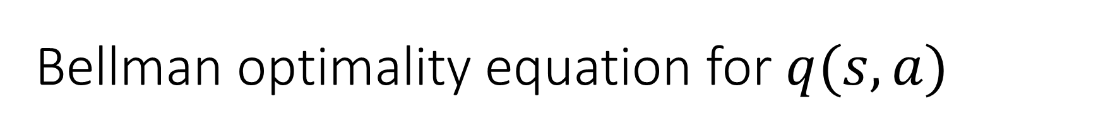
Bellman optimality equation for $q(s,a)$
Recall Bellman expectation equation first
$$q_{π}\left(s,a\right)=\sum_{r,s′}{p\left(r,s^{′} | s,a\right) [r+γ\sum_{a′}{π(a^{′}|s^{′})q_{π}(s^{′},a^{′})}] }$$
Defining now Bellman optimality equation
$$q_{∗}\left(s,a\right)=𝔼_{π}\left[R_{t}+γ\max_{a′}{q_{∗}\left(S_{t+1}, a^{′}\right)|S_{t}=s,A_{t}=a}\right]$$
This can be written as
$$q_{∗}\left(s,a\right)=\sum_{r,s′}{p(r,s^{′}|s,a)\left[r+γ\max_{a′}{q_{∗}(s^{′},a^{′})}\right]}$$
Worth noting that so far we have been dealing with model-based RL

Slide 32
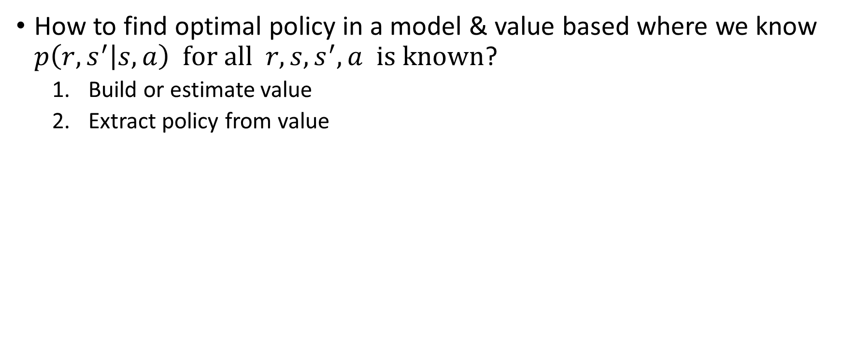
Model-based setup with value-based approach
How to find optimal policy in a model & value based where we know $p\left(r,s^{′} | s,a\right) for all r,s,s^{′},a is known$?
Build or estimate value
Extract policy from value

Slide 33
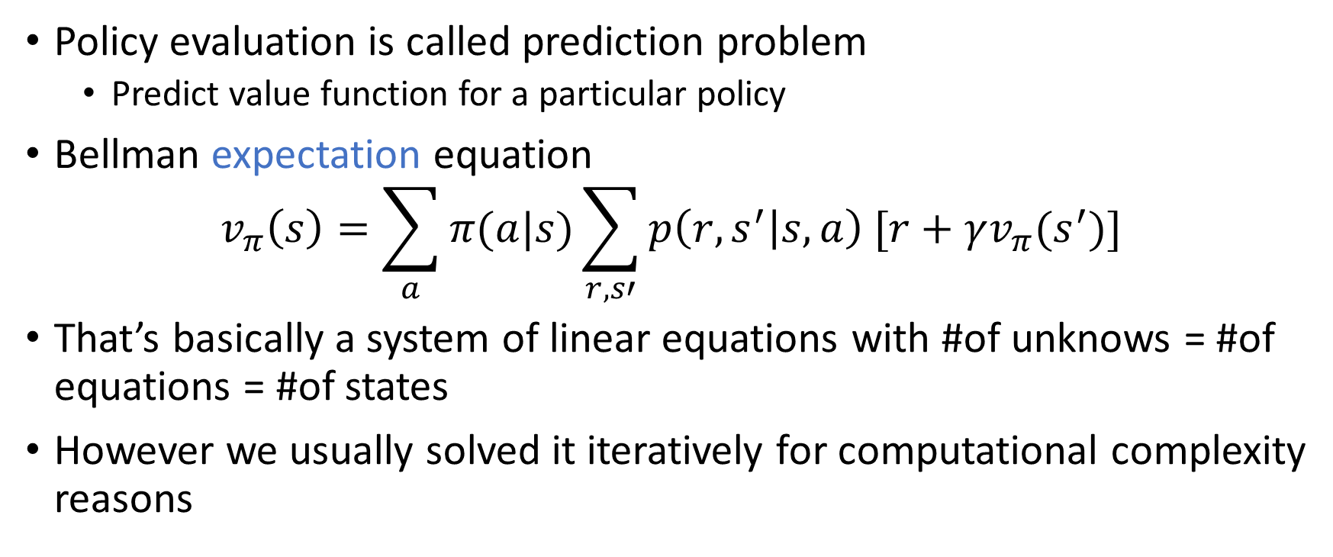
Policy Evaluation: Motivation
Policy evaluation is called prediction problem
Predict value function for a particular policy
Bellman expectation equation
$$v_{π}\left(s\right)=\sum_{a}{π(a|s)\sum_{r,s′}{p\left(r,s^{′} | s,a\right) [r+γv_{π}(s^{′})]}}$$
That’s basically a system of linear equations with #of unknows = #of equations = #of states
However we usually solved it iteratively for computational complexity reasons

Slide 34
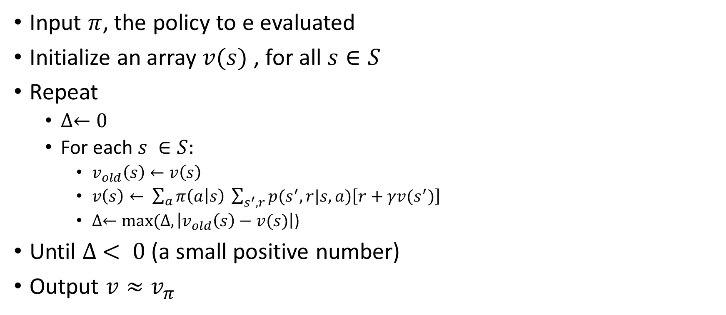
Policy evaluation with iterative algorithm
Input $π$, the policy to e evaluated
Initialize an array $v(s)$ , for all $s∈S$
Repeat
$∆←0$
For each $s ∈S:$
$v_{old}\left(s\right)←v\left(s\right)$
$v\left(s\right)← \sum_{a}{π\left(a | s\right) \sum_{s^{′},r}{p(s^{′},r|s,a)\left[r+γv(s^{′})\right]}}$
$∆←max⁡(∆, \left|v_{old}\left(s\right)−v(s)\right|$)
Until $∆ < 0$ (a small positive number)
Output $v≈v_{π}$

Slide 35
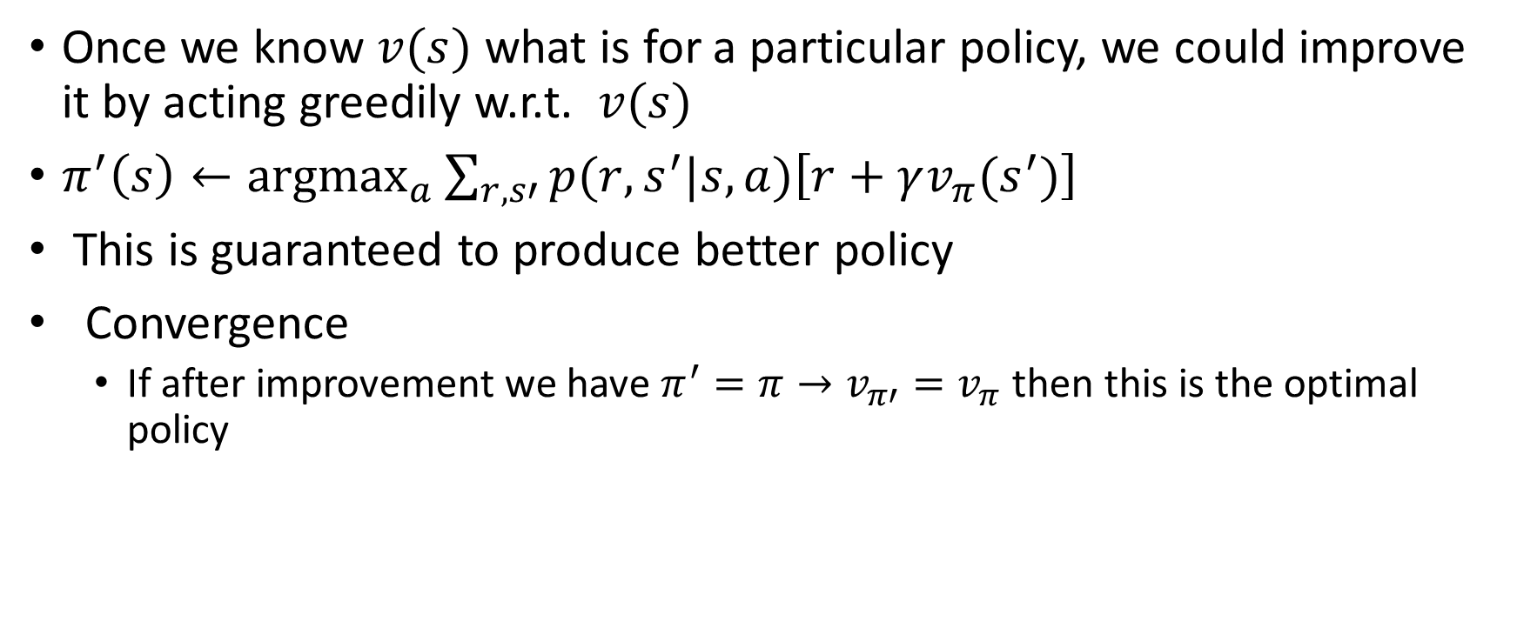
Policy Improvement: an idea
Once we know $v(s)$ what is for a particular policy, we could improve it by acting greedily w.r.t. $v(s)$
$π^{′}\left(s\right)←\underset{a}{argmax}{\sum_{r,s′}{p(r,s^{′}|s,a)\left[r+γv_{π}(s^{′})\right]}}$
This is guaranteed to produce better policy
Convergence
If after improvement we have $π^{′}=π→v_{π′}=v_{π}$ then this is the optimal policy

Slide 36
Roadmap
Now we know what is
Policy evaluation (based on Bellman expectation equation)
Policy improvement (based on Bellman optimality equation)
The final piece: how to combine these to get an optimal policy?
Generalized policy iteration
There are two extreme ways to implement generalized policy iteration
Policy iteration
Value iteration
Policy evaluation
Policy improvement

Slide 37
Policy iteration
Evaluate policy until convergence (with some tolerance)
Value iteration
Evaluate policy only with single iteration
Improve policy
Improve policy
PI is slower per cycle but requires fewer cycles
PI is faster per cycle but requires more cycles
Modified policy iteration
Limits number of iterations to $K$in policy evaluation
Limits number of iterations to 𝐾 in policy evaluation

Slide 38
We will focus on value iteration

Slide 39
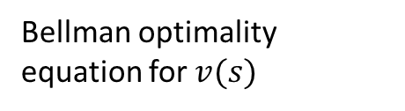
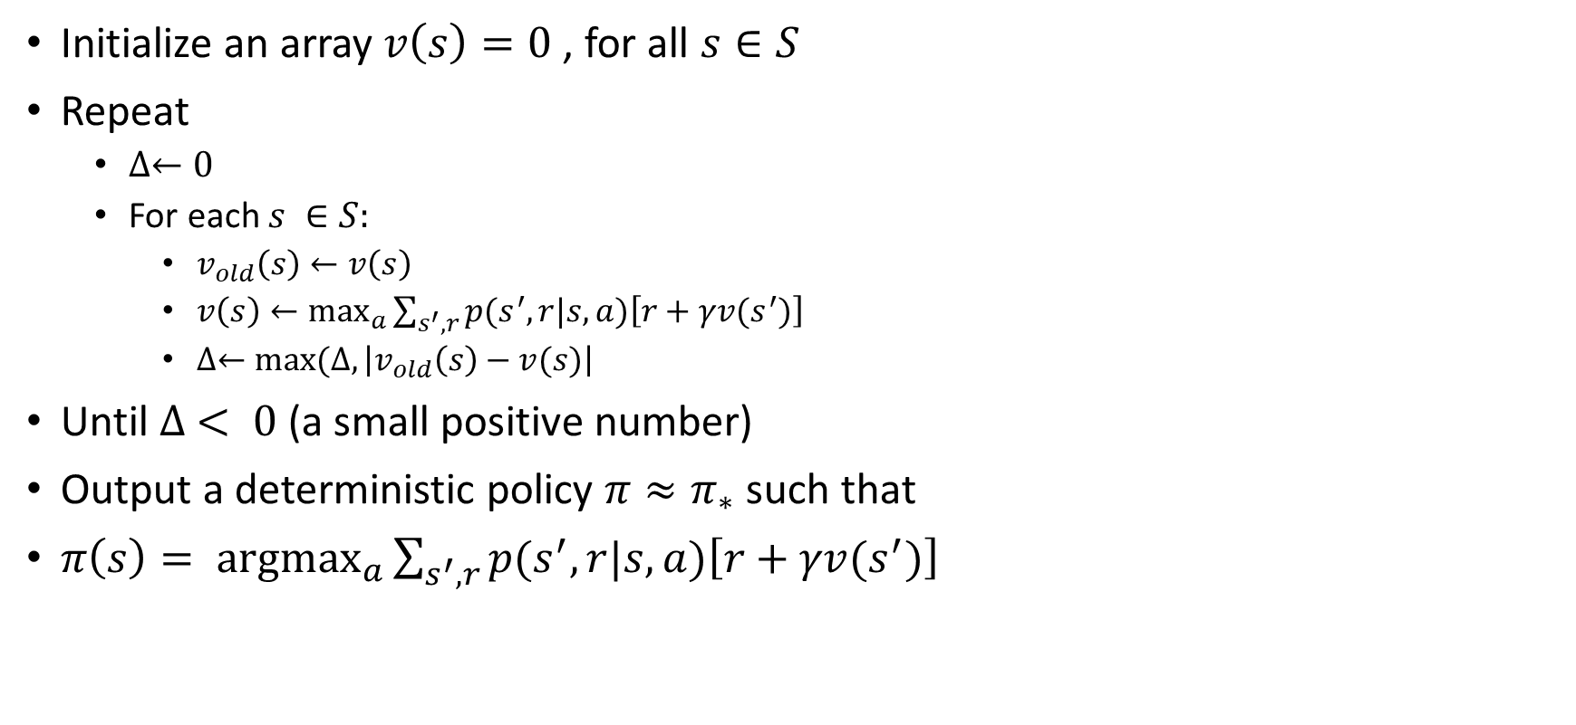
Value Iteration
Initialize an array $v\left(s\right)=0$ , for all $s∈S$
Repeat
$∆←0$
For each $s ∈S:$
$v_{old}\left(s\right)←v\left(s\right)$
$v\left(s\right)←\max_{a}{\sum_{s^{′},r}{p(s^{′},r|s,a)\left[r+γv(s^{′})\right]}}$
$∆←max⁡(∆, \left|v_{old}\left(s\right)−v(s)\right|$
Until $∆ < 0$ (a small positive number)
Output a deterministic policy $π≈π_{∗}$ such that
$π\left(s\right)= \underset{a}{argmax}{\sum_{s^{′}, r}{p(s^{′},r|s,a)\left[r+γv(s^{′})\right]}}$
Bellman optimality equation for $v(s)$
Value Iteration only contains one component. It updates the value function V based on the Optimal Bellman Equation.
After the iteration converges, the optimal policy is straight-forwardly derived by applying an argument-max function for all of the states.

Slide 40
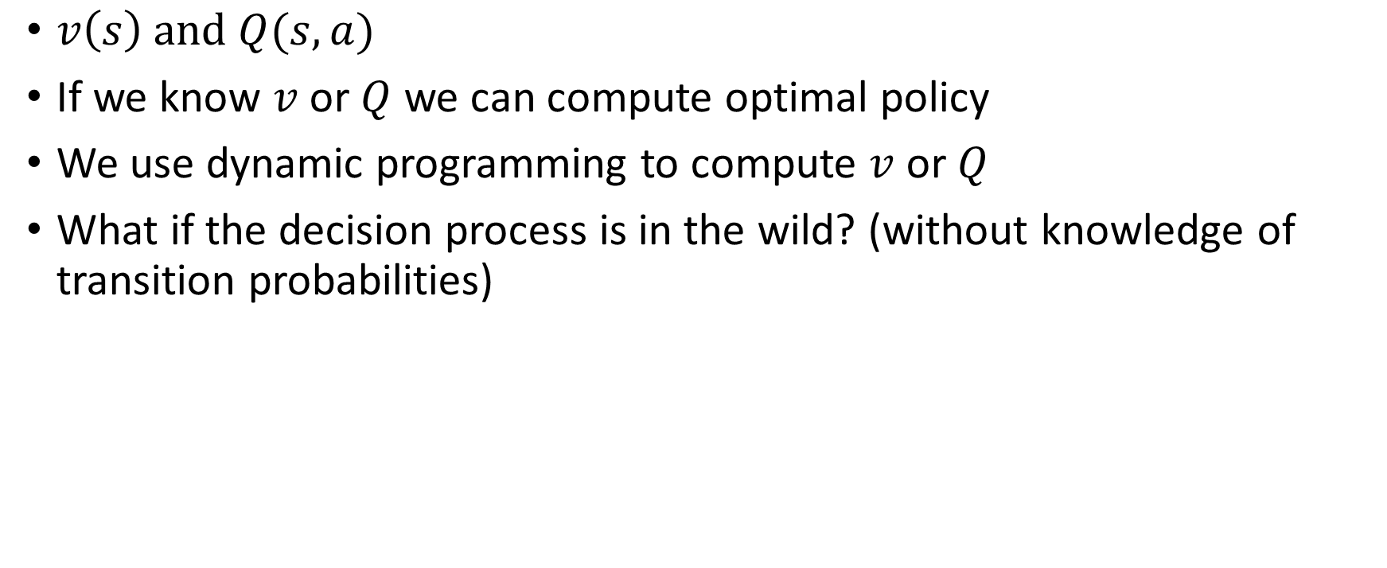
What we learned so far
$v\left(s\right) and Q(s,a)$
If we know $v$ or $Q$ we can compute optimal policy
We use dynamic programming to compute $v$ or $Q$
What if the decision process is in the wild? (without knowledge of transition probabilities)

Slide 41

Decision Process in The Wild
Agent
Can do anything
observation
action
Can’t even see

Slide 42
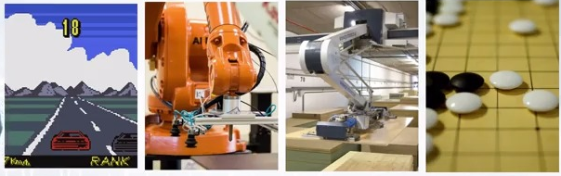
Decision Process in The Wild
Agent
Can do anything
observation
action
Can’t even see

Slide 43
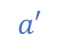
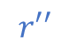

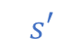
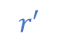
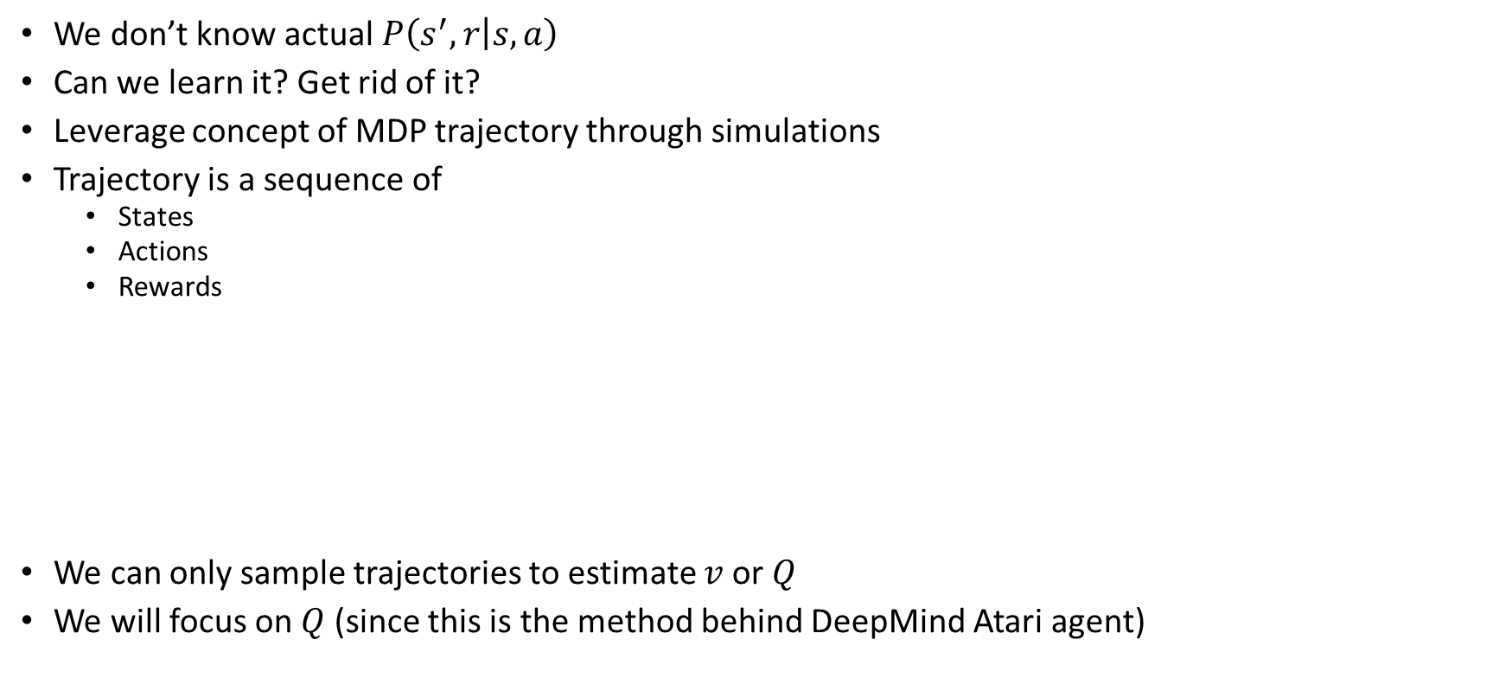
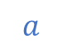
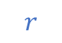
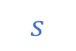
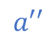


Model-free Setting
We don’t know actual $P\left(s^{′},r | s,a\right)$
Can we learn it? Get rid of it?
Leverage concept of MDP trajectory through simulations
Trajectory is a sequence of
States
Actions
Rewards
We can only sample trajectories to estimate $v$or $Q$
We will focus on $Q$ (since this is the method behind DeepMind Atari agent)
prev $s$
$$s′$$
$$r′$$
$$r$$
$$r′′$$
$$s$$
$s$’’
prev $a$
$$a$$
$$a′$$
$$a′′$$

Slide 44
Methods for Estimating Q
Monte Carlo
TD learning
Q-learning (basic method behind Deep Mind Atari)

Slide 45












Method 1: MC
Get all trajectories containing particular $\left(s,a\right)$
Estimate $G(s,a)$
Average them to get expectation
Unbiased estimate but takes lots of sessions
Needs full trajectories!
prev $s$
$$s′$$
$$r′$$
$$r$$
$$r′′$$
$$s$$
$s$’’
prev $a$
$$a$$
$$a′$$
$$a′′$$

Slide 46

Method 2: Temporal Difference
Rember we can improve $Q\left(s,a\right)$ iteratively
$$Q\left(s_{t},a_{t}\right)←\underset{r_{t},s_{t+1}}{E}{r_{t}+γ\max_{a^{′}}{Q\left(s_{t+1},a^{′}\right)}}$$
Replace expectation with sampling
$$Q\left(s_{t},a_{t}\right)≈\frac{1}{N}\sum_{i}{r_{t}+γ\max_{a^{′}}{Q\left(s_{i+1},a^{′}\right)}}$$
Use moving average with just one sample
$$Q\left(s_{t},a_{t}\right)←α{(r}_{t}+γ\max_{a′}{Q(s_{t+1},a^{′}))+(1−α)Q(s_{t},a_{t})}$$

Slide 47











Method 3: Q-learning
$$Q(s^{′},a_{0})$$
prev $s$
$$s′$$
$$Q(s^{′},a_{1})$$
$$r$$
$$s$$
$$Q(s^{′},a_{2})$$
prev $a$
$$a$$
$$Q(s^{′},a_{3})$$
Initialize $Q\left(s,a\right)$ with zeros
Loop:
Sample $<s,a,r,s^{′}>from env$
Compute $\hat{Q} \left(s,a\right)=r\left(s,a\right)+γ\max_{a_{i}}{Q(s^{′},a_{i})}$
Update $\hat{Q} \left(s,a\right)←α \hat{Q}\left(s,a\right)+\left(1−α\right)Q(s,a)$

Slide 48
MC vs TD & Q
Monte-Carlo
Averages Q over sampled paths
Temporal Difference and Q-learning
Uses recurrent relation for Q
Needs full trajectory to start learning
Can learn from partial episodes
Biased estimates
Unbiased estimates

Slide 49

Q-learning: bit more details
$$Q\left(s_{t},a_{t}\right)←Q\left(s_{t},a_{t}\right)+α\left[r_{t+1}+γ\max_{a}{Q\left(s_{t+1},a\right)−Q(s_{t},a_{t})}\right]$$
$α$refers to the learning rate (i.e. how fast are we approaching the goal).
Model-free, we do not need to worry about transition probability
Note that the next action $a′$ is chosen to maximize the next state’s Q-value instead of following the current policy. As a result, Q-learning belongs to the off-policy category

Slide 50


Slide 51
Q-learning convergence
If all state-action pairs are visited a sufficiently large number of times, the Q-learning algorithm is guaranteed to eventually converge on the optimal table, although how long convergence takes is another matter.

Slide 52
What could possibly go wrong?

Slide 53

Our mobile robot learns to walk
Naïve Q-learning can lead to positive feedback loop where agent learns to get small reward (>0) but never able to fully walk
For example if falling down gives use small positive value then this could lead you to always walk and then fall to maximize reward! Agent takes best action according to its point of view
Partly here the reward needs to be designed in a better way and we need to explore more the space! (Maybe there are even more optimal actions than he can currently think of)

Slide 54


Exploration vs Exploitation
Balance between using what we learned and trying new things that may lead to better solutions
A popular strategy is $ε$–greedy method
With probability $ε$take random action, otherwise take optimal action
Picture credit: Berkley CS188x: http://ai.berkeley.edu/home.html

Slide 55

Exploration Over Time
If you want to converge to optimal policy you need to gradually decrease exploration, i.e. decrease $ε$
In the limit of $ε=0$it becomes greedy
Take care of non-stationary environments where exploration should be always tried (even if at small rates), otherwise we will not be able to adapt to changing environment, for example in the case of showing ads for search queries

Slide 56
What can go wrong in epsilon greedy Q-learning?

Slide 57

Cliff World
Picture credit: Berkley CS188x: http://ai.berkeley.edu/home.html

Slide 58


Cliff World
Conditions
Q-learning
$γ=0.99, ∈=0.1$
What will Q-learning learn
Shortest path
Will it maximize reward
No, robot will all due to $ε$ – greedy exploration
In this case using epsilon greedy Q-learning can lead to suboptimal solution

Slide 59
SARSA
SARSA very much resembles Q-learning. The key difference between SARSA and Q-learning is that SARSA is an on-policy algorithm. It implies that SARSA learns the Q-value based on the action performed by the current policy instead of the greedy policy (SARSA is on-policy algorithm)
The goal of SARSA is to avoid getting stuck in a bad choice by not selecting a greedy choice when we do something like epsilon greedy exploration in Q-learning
SARSA uses the action that follows from current policy while Expected SARSA uses expectation over all possible actions
SARSA
$$Q\left(s_{t},a_{t}\right)←Q\left(s_{t},a_{t}\right)+α\left[r_{t+1}+γQ\left(s_{t+1},a_{t+1}\right)−Q(s_{t},a_{t})\right]$$
Q-learning
$$Q\left(s_{t},a_{t}\right)←Q\left(s_{t},a_{t}\right)+α\left[r_{t+1}+γ\max_{a}{Q\left(s_{t+1},a\right)−Q(s_{t},a_{t})}\right]$$

Slide 60

Difference between Q-learning & SARSA
SARSA gets optimal rewards under current exploration strategy
Q-learning policy would be optimal without exploration

Slide 61
Expected SARSA vs SARSA vs Q-learning
Expected SARSA is the most universal of the three because you can set the pdf on which you take expectation
If you make pdf focused on the best action of the policy (e.g. human driving from recorded sessions of driving), then this becomes on-policy → SARSA
If you make pdf centered on the best possible action (like something in epsilon greedy with epsilon close to zero), then you will select the best action greedily → off policy → Q learning

Slide 62
On-policy vs Off-policy
On-policy
Agent always follows his own policy
Off-policy
Agent pick actions that maximizes next rewards
Learning from expert (expert is imperfect), maybe we can do better than expert!
Learning from recorded sessions
Example: DQN (Deep-Q-Network)
Typical examples are the various Policy-Gradient methods such as REINFORCE and A3C (Asynchronous Advantage Actor-Critic)

Slide 63
Simple Example: the maze, model-based case

Slide 64

Maze Example
Goal: to train a robot to find the optimal path through this maze, starting from cell (0, 0) and ending in cell (6, 6), without prior knowledge of the environment.
Rewards: To encourage shortest path, small penalty of 0.04 units is applied each time the robot moves into an empty (white) cell, and obstacles are places around the maze (marked in gray) which result in a larger penalty of 0.75 units if the robot enters a cell containing one of them.
Possible actions: move up, down, left or right. However, a level of uncertainty is associated with each movement, such that there is only an 80% chance the robot will move in the intended direction and a 20% chance the robot moves at right angles to the intended direction (split evenly between the two possibilities).
https://samyzaf.com/ML/rl/qmaze.html

Slide 65

Maze Solution
Parameters
Discount rate of 0.9,
learning rate of 0.3
epsilon greedy exploration strategy with (constant) epsilon equal to 0.5
50,000 iterations of the Q-learning algorithm we get the following policy
Optimal direction for the robot to take in each square of the grid
https://github.com/gkhayes/maze_reinforcement_learning
C:\Users\melsaban\Documents\Books\ReinforcementLearning\Code\maze_reinforcement_learning

Slide 66
Are we done?

Slide 67

Limitations of Tabular Methods
Reinforcement learning can be used to solve large problems, e.g.
Backgammon: 10²⁰ states
Computer Go: 10¹⁷⁰ states
Helicopter: continuous state space
Could be more than the number of atoms in the universe!
How can we scale up model-free methods?
Memory
Time
Estimate $v$or $Q$ with function approximation
Generalize from seen states to unseen states

Slide 68
Types of Value/Q Function Approximation
Credit: David Silver course: http://www0.cs.ucl.ac.uk/staff/d.silver/web/Teaching.html

Slide 69


Let’s assume we know the true $Q_{π}(s,a)$
Loss can be MAE, MSE or other forms
$$ℒ\left(w\right)= \frac{1}{2}\sum_{s,a}{{\left[Q_{π}\left(s,a\right)−\hat{Q}(s,a,w)\right]}^{2}}$$
This is now a supervised learning problem
We can apply any favorite supervised ML algorithm
One possible variation is to weigh $\left(s,a\right)$differently
$$ℒ\left(w\right)= \frac{1}{2}\sum_{s,a}{{ρ_{π}\left(s,a\right)\left[Q_{π}\left(s,a\right)−\hat{Q}(s,a,w)\right]}^{2}}$$

Slide 70


Bu we don’t know true target${ Q}_{π}(s,a)$!
Solution: define target using recursion
$$g\left(s,a\right)=R\left(s,a\right)+γ\max_{a}{\hat{Q_{π}}(s_{t+1},a,w)}$$
We are back to a supervised setting
But note that we are using an estimated value inside the target

Slide 71

Deep Q Network (DQN)
For complex problems with many states and actions, one may need a deep network to approximate the $Q$ function
DQN leverages a Neural Network to approximate the $Q$-value function.
The input for the network is the current state , while the output is the corresponding $Q$-value for each of the action ($Q(s,a)$).

Slide 72
Deep Q-learning for Atari games
This algorithm, from DeepMind labs, was evaluated on Atari 2600, and several other computer games.
The same single architecture was used in all these games and this algorithm showed much better results than any other RL methods available!
Deep RL is a combination of Deep-learning (convolutional neural network) and Reinforcement learning (Q-learning).
Paper: https://www.cs.toronto.edu/~vmnih/docs/dqn.pdf

Slide 73

DQN Bird’s Eye View
Breakthrough successful application of RL
Directly learn from visual inputs (as humans do)
Shown for a wide variety of Atari games
Deep convolutional network (from states to $Q(s,a)$)
No hand engineered features
$Q$-learning with stability tricks
$ε$-greedy optimization
Picture credit: https://www.cs.toronto.edu/~vmnih/docs/dqn.pdf

Slide 74

DQN Bird’s Eye View
Picture credit: https://www.nature.com/articles/nature14236

Slide 75
Network Architecture
Q-values
18
Linear
Dense
ReLU
Initial Image
210x160x3
Conv
ReLU
Pooling helps in adding translation invariance: good for classification , but in games translation invariance could be bad because you need exact ball position in a game for example
Gray-scale and downsample
110x84x1
Conv
ReLU
Crop
84x84x1
No pooling
Conv
Stack 4 most recent frames
84x84x4
Adding Context
Gives position, velocity, acceleration of ball for instance
84

Slide 76
Sample Results
Original paper of DeepMind, 2015
Usually trained with more than 5M steps
It usually takes about ~40h on Tesla K80 GPU or ~90h on 2.9 GHz Intel i7 Quad-Core CPU
Table from: https://www.cs.toronto.edu/~vmnih/docs/dqn.pdf

Slide 77

DQN instability issues
Sequential correlated data
May hurt convergence and performance
Policy may diverge or oscillate
Target is not constant and is function of $w$
Over estimation problem
$Q$-learning tends to overestimate $Q$ because of successive use of max operation
Unstable gradients
Reward scale is unbounded

Slide 78

DQN instability issues: Solutions
Sequential correlated data
Experience replay
Policy may diverge or oscillate
Target networks
Unstable gradients
Reward clipping
Over estimation problem
Separate max into two operations: double $Q$-learning

Slide 79

DQN instability issues: Solutions
Sequential correlated data
Experience replay
Policy may diverge or oscillate
Target networks
Unstable gradients
Reward clipping
Over estimation problem
Separate max into two operations: double $Q$-learning

Slide 80

Experience Replay
Idea: store several past interactions $<s,a,r,s^{′}>$
Train on random subsamples
Training curriculum
Play $1$ step and record it
Pick $N$ random samples to train
Idea is not just applicable to $Q$-learning
Experience learning helps decorrelate input since input is not iid and you may not unlearn bad behavior
Can give you more samples, specially if getting actual samples is hard (you have to drive an actual car for example not just simulate)

Slide 81
Experience Replay
Advantages
Helps against correlations
Increases sample efficiency
Reduce variance of updates
Computations are easy to parallelize
Disadvantages
Memory intensive (DQN stored 1 million interactions)
Random sampling form pool could be improved
Older interactions we obtained under weaker policy

Slide 82

DQN instability issues: Solutions
Sequential correlated data
Experience replay
Policy may diverge or oscillate
Target networks
Unstable gradients
Reward clipping
Over estimation problem
Separate max into two operations: double $Q$-learning

Slide 83


Policy Oscillation
Targets are not independent of $w$
Solution is to build a network to predict the target
Have two networks one to estimate Q and one to estimate the target itself
$$g\left(s,a\right)=R\left(s,a\right)+γ\max_{a}{\hat{Q_{π}}(s_{t+1},a,w)}$$
Synchronize between them once in a while, since they should be solving for same $w$ at the end of the day
Picture credit: https://cdn-images-1.medium.com/max/1000/1*Vd1kcpLoQDnM5vrKnvzxbw.png

Slide 84

DQN instability issues: Solutions
Sequential correlated data
Experience replay
Policy may diverge or oscillate
Target networks
Unstable gradients
Reward clipping
Over estimation problem
Separate max into two operations: double $Q$-learning

Slide 85

Unstable Gradients
Don’t know the scale of the reward beforehand
May cause numeric problems with large $Q$-values
Clip the reward to [-1,1]
Advantages
Less peaky $Q$-values
More stable gradients
Disadvantages
May not be able to differentiate between good and great (because of clipping)

Slide 86

DQN instability issues: Solutions
Sequential correlated data
Experience replay
Policy may diverge or oscillate
Target networks
Unstable gradients
Reward clipping
Over estimation problem
Separate max into two operations: double $Q$-learning

Slide 87

Over Estimation Problem
Deep Q-learning is known to sometimes learn unrealistically high action values because it includes a maximization step over estimated action values, which tends to prefer overestimated to underestimated values (in a non-uniform way across $(s,a)$, if uniform this will not cause an issue)
The idea of Double Q-learning is to reduce overestimations by decomposing the max operation in the target into action selection and action evaluation.
Train two separate networks for action selection and action evaluation
Shown to improve agent performance

Slide 88


Double $Q$-learning
Classic DQN
$$\hat{Q}\left(s_{t},a_{t}\right)←r_{t+1}+γ\max_{a}{Q\left(s_{t+1},a\right)}$$
Double DQN
$$\hat{Q}\left(s_{t},a_{t}\right)←r_{t+1}+γ Q\left(s_{t+1},\underset{a}{argmax}{Q\left(s_{t+1},a\right)}\right)$$
Idea: train two separate networks
Objective for $Q_{1}$
$$\hat{Q_{1}}\left(s_{t},a_{t}\right)←r_{t+1}+γ Q_{2}\left(s_{t+1},\underset{a}{argmax}{ Q_{1}\left(s_{t+1},a\right)}\right)$$
Objective for $Q_{2}$
$$\hat{Q_{2}}\left(s_{t},a_{t}\right)←r_{t+1}+γ Q_{1}\left(s_{t+1},\underset{a}{argmax}{ Q_{2}\left(s_{t+1},a\right)}\right)$$
Instead of training two different networks, we use the $Q$ and target networks to avoid excessive training time

Slide 89
RL Frameworks/Environments

Slide 90
RL frameworks/environments
For those looking to get started in RL, however, one of the biggest obstacles has historically been getting hold of an interesting and challenging environment in which to experiment.
This is the reason why RL is the least known member of the machine learning family. Yet, since the introduction of OpenAI Gym, this is no longer the case.
OpenAI Gym is a Python package comprising a selection of RL environments, ranging from simple “toy” environments, such as the one described in the example, to more challenging environments, including simulated robotics environments and Atari video game environments.

Slide 91
Small intro to openAI gym

Slide 92

OpenAI gym Example
https://gym.openai.com/docs/

Slide 93

OpenAI gym Example 2
import gym
env = gym.make('CartPole-v0’)
for i_episode in range(20): observation = env.reset()
for t in range(100):
env.render() print(observation) action = env.action_space.sample()
observation, reward, done, info = env.step(action)
if done:
print("Episode finished after {} timesteps".format(t+1))
Break
env.close()
https://gym.openai.com/docs/

Slide 94
OpenAI gym environments
Environments

Slide 95
Open AI baselines
OpenAI Baselines is a set of high-quality implementations of reinforcement learning algorithms
These algorithms will make it easier for the research community to replicate, refine, and identify new ideas, and will create good baselines to build research on top of.
DQN implementation and its variants are roughly on par with the scores in published papers.

Slide 96
A challenge!
DeepTraffic from MIT
https://selfdrivingcars.mit.edu/deeptraffic/
Try to break maximum speed record!
Blog addressing it
https://towardsdatascience.com/deeptraffic-dqn-tuning-for-traffic-navigation-75-01-mph-solution-23087e2411cf

Slide 97
Practical Session

Slide 98
References
Sutton & Barto book
http://incompleteideas.net/book/bookdraft2017nov5.pdf
Best courses out there
Coursera practical course: https://www.coursera.org/learn/practical-rl?specialization=aml
DeepMind, David Silver: RL Course by David Silver - Lecture 4: Model-Free Prediction
For deep RL, the best course is that by Berkley http://rail.eecs.berkeley.edu/deeprlcourse/
http://web.stanford.edu/class/cs234/index.html
MIT 6.S094: Deep Reinforcement Learning for Motion Planning
RL environments/frameworks
OpenAI gym
Pygame
Amazon deep racer
Deep Traffic from MIT: https://selfdrivingcars.mit.edu/deeptraffic/
OpenAI bAselines: https://github.com/openai/baselines
Paper links
Reinforcement Learning Algorithms: Survey and Classification , Indian Journal of Science and Technology, Vol 10(1), DOI: 10.17485/ijst/2017/v10i1/109385 January 2017 http://www.indjst.org/index.php/indjst/article/viewFile/109385/77763
http://www.cs.toronto.edu/~zemel/documents/411/rltutorial.pdf
http://web.eecs.umich.edu/~baveja/NIPS05RLTutorial/NIPS05RLMainTutorial.pdf
DQN deepMind paper on Atari games: https://www.cs.toronto.edu/~vmnih/docs/dqn.pdf, https://www.nature.com/articles/nature14236
DeepTraffic https://arxiv.org/pdf/1801.02805.pdf
AlphGo: https://deepmind.com/documents/119/agz_unformatted_nature.pdf
Paper + code website
https://paperswithcode.com/search?q=reinforcement+learning

Slide 99
References
Useful blogs
https://towardsdatascience.com/reinforcement-learning-with-python-8ef0242a2fa2
https://towardsdatascience.com/getting-started-with-reinforcement-learning-and-open-ai-gym-c289aca874f
https://towardsdatascience.com/reinforcement-learning-with-python-8ef0242a2fa2
https://medium.freecodecamp.org/an-introduction-to-q-learning-reinforcement-learning-14ac0b4493cc
https://www.kdnuggets.com/2018/03/5-things-reinforcement-learning.html
https://towardsdatascience.com/self-learning-ai-agents-part-i-markov-decision-processes-baf6b8fc4c5f
https://towardsdatascience.com/self-learning-ai-agents-part-ii-deep-q-learning-b5ac60c3f47
https://adventuresinmachinelearning.com/reinforcement-learning-tensorflow/
https://towardsdatascience.com/deep-double-q-learning-7fca410b193a
https://towardsdatascience.com/the-other-type-of-machine-learning-97ab81306ce9
Conferences
Neural Information Processing Systems (NIPS)
International Conference on Machine Learning (ICML)
AAAI, IJCAI, Agents, COLT,...
Journals
Journal of Artificial Intelligence Research (JAIR) [free online]
Journal of Machine Learning Research (JMLR) [free online]
Neural Computation, Neural Networks
Machine Learning, AI journal, ...

